Slide 1


software project management
BATTLE FOR THE ORIGINIUM
LEINUOZHEN(PM) WANGLIN
ZHOUZITAO ZHONGRUIZHE

Slide 2





Battle for the Originium
CONTENTS
01/ Introduction
02/Project Development
process（leangoo）
Market research and software analysis
Design the software development process
03/Project Evaluation
04/Project Development report
Evaluation of software encountered during design testing
Summary of reports on current software development progress

Slide 3
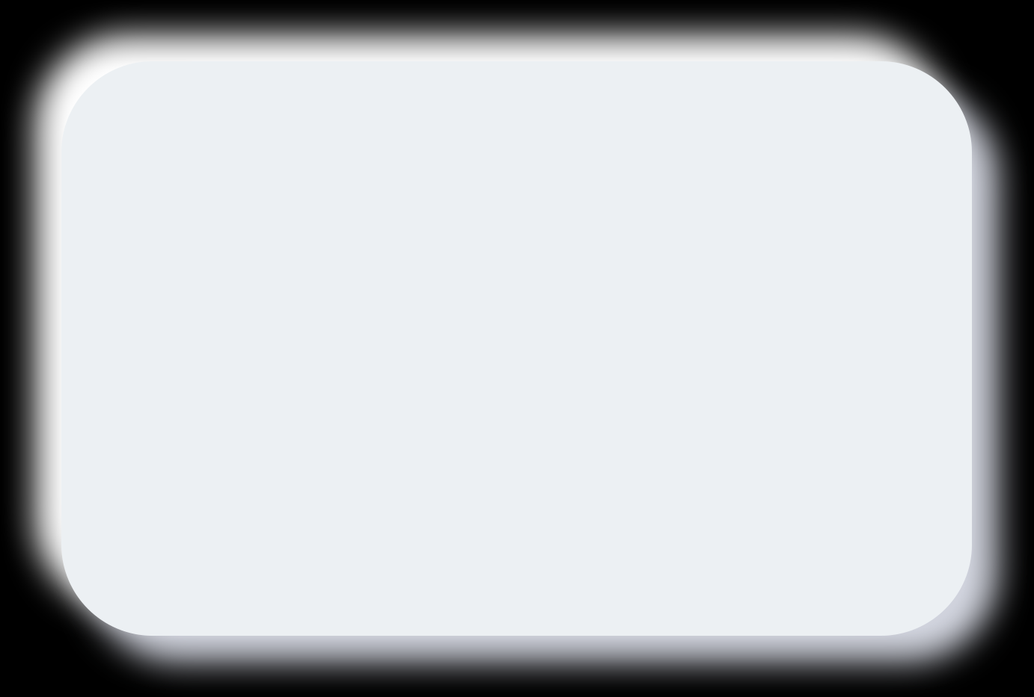
Battle for the Originium
INTRODUCTION
-4P
01
Zhong Ruizhe
Market research and software analysis

Slide 4

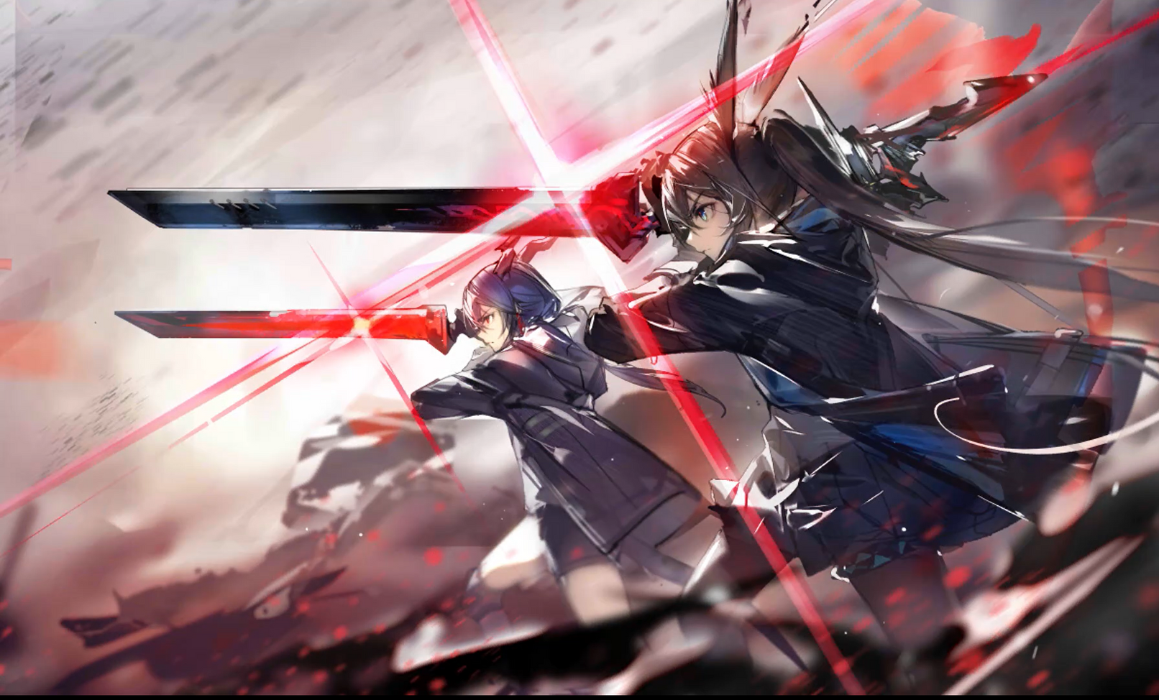





Battle for the Originium
interactivity
New forms of play
Diversity
and depth
Fan base
backstory

Slide 5







People
Battle for the Originium
Lei Nuozhen
Wang Lin
Zhou Zitao
Zhong Ruizhe
PM
member
member
member
developer
tester
developer
tester

Slide 6
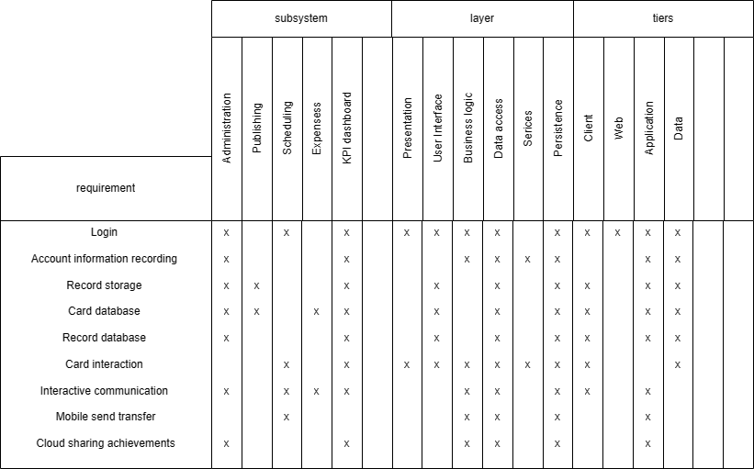

Product
Battle for the Originium
Requirements Traceability Matrix
Requirement
Login
Account information recording
Record storage
Card database
Record database
Card interaction
Interactive communication
Cross-device delivery of mobile commands
Game performance sharing in the cloud

Slide 7
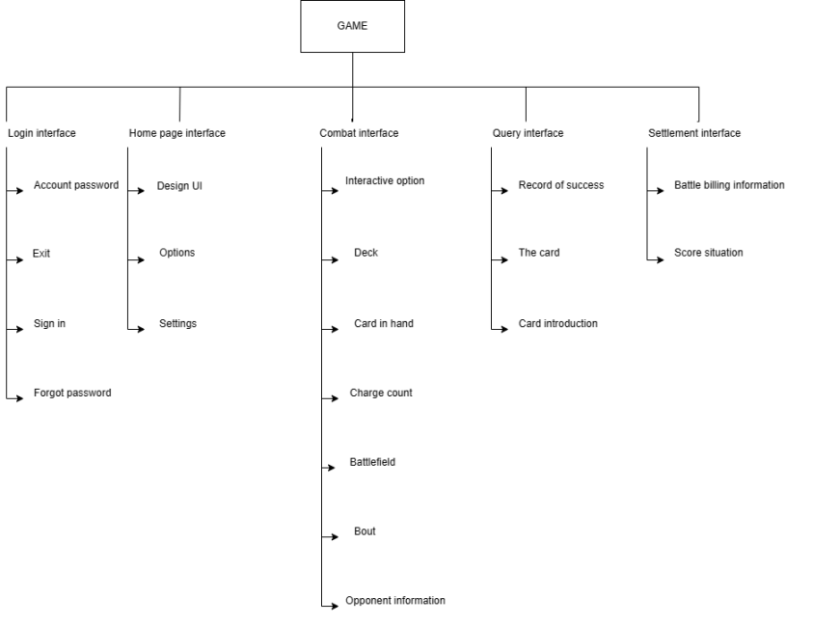
Product WBS
Battle for the Originium

Slide 8
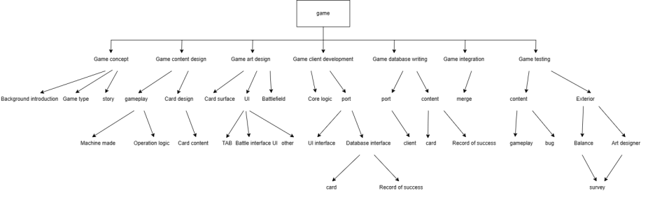
Process WBS
Battle for the Originium

Slide 9
Project
Battle for the Originium
How to avoid problems?
conduct a postmortem analysis
smart decisions
W5HH principle

Slide 10

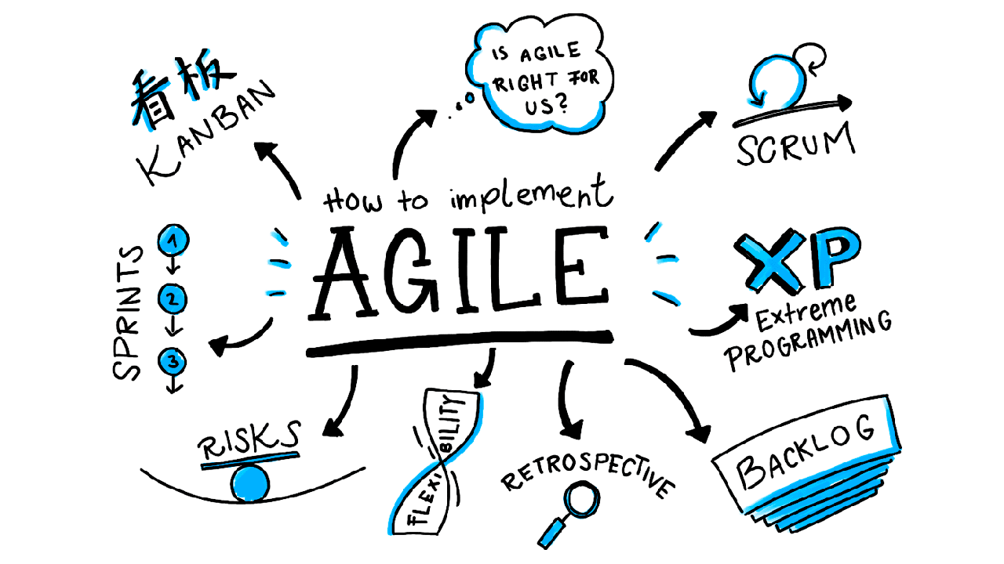
Battle for the Originium
Scrum model

Slide 11
Battle for the Originium
PROJECT DEVELOPMENT
process（leangoo）
02
Wang Lin
Design the software development process

Slide 12

Battle for the Originium
Work flow arrangement
Product roadmap
A general schedule of all work on the project, including preparation, development, testing, and regular meetings
sprint1
Accomplish the tasks in the preparatory phase and do the preliminary work well
sprint2
The initial development of the product, including the construction of the game framework, the design of the game client ui, and the art design

Slide 13
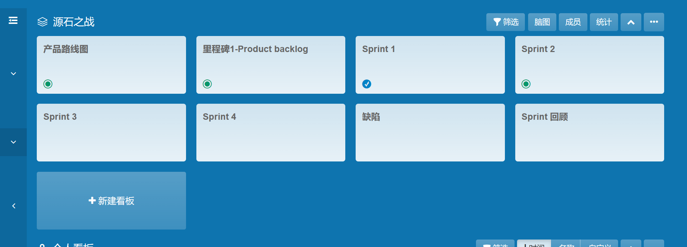

Slide 14

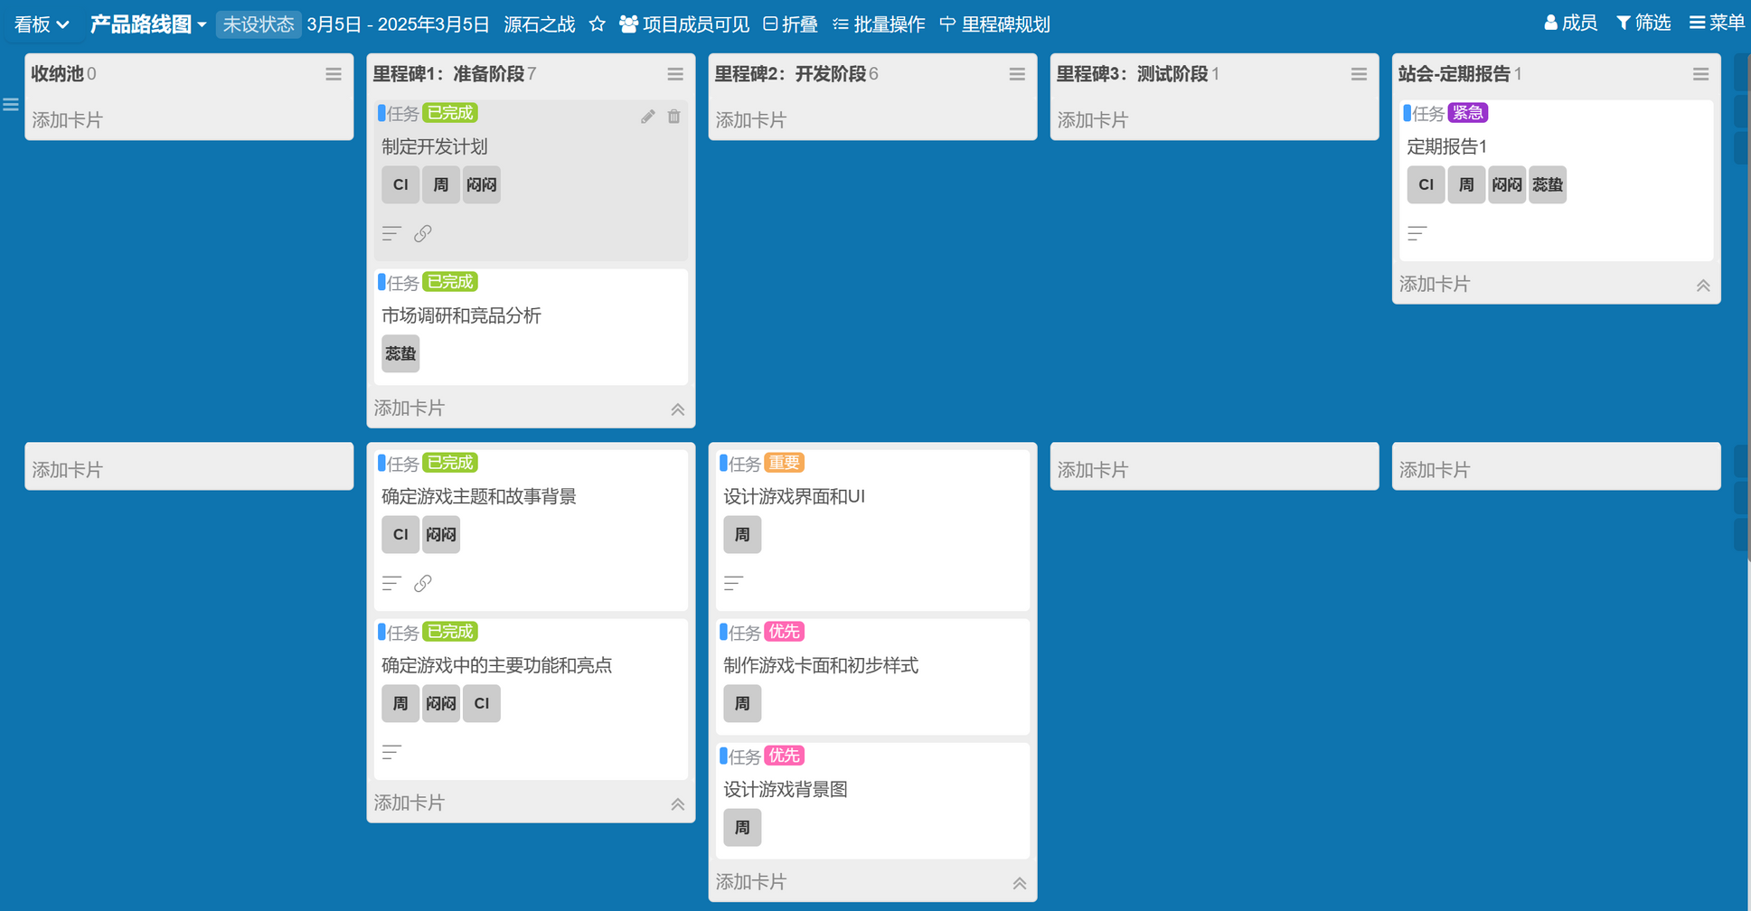
Product roadmap
Battle for the Originium

Slide 15
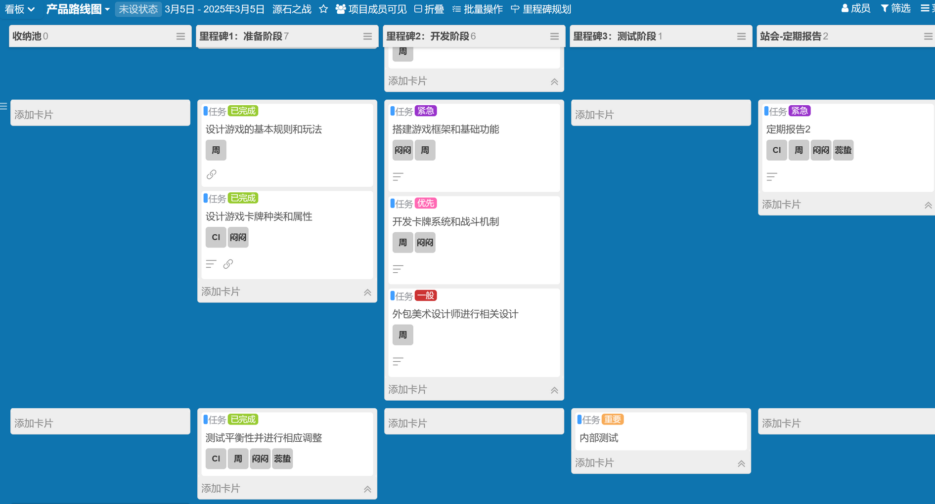
Product roadmap
Battle for the Originium

Slide 16
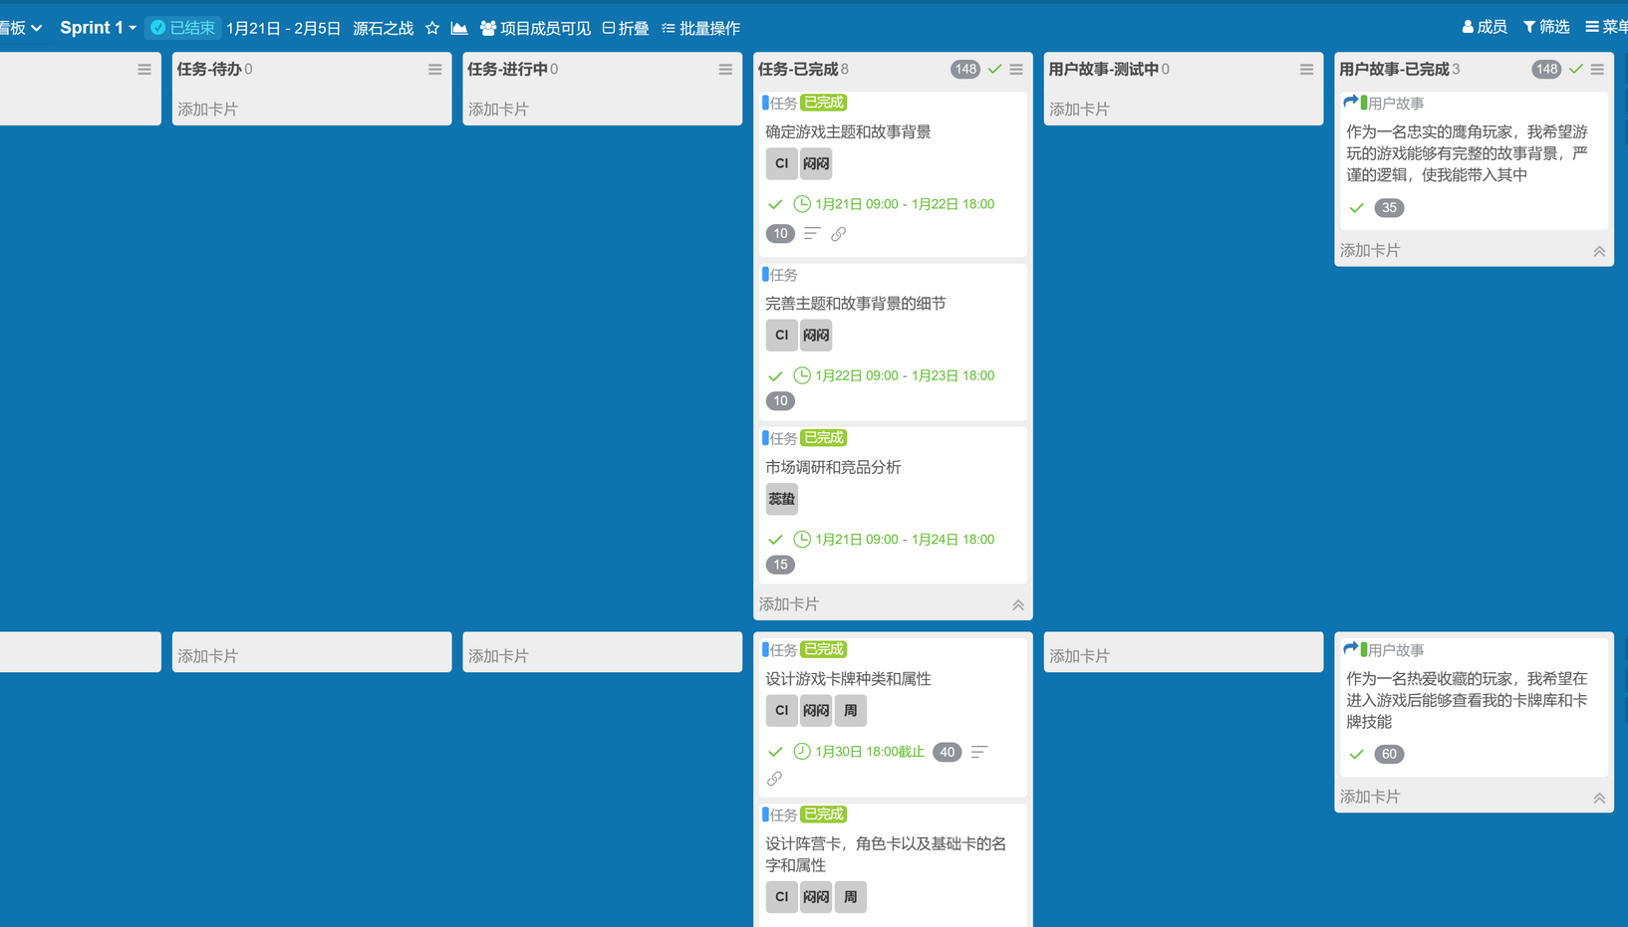
sprint 1 1.21-2.5
Do market research,
Design the game's backstory
Design related cards

Slide 17
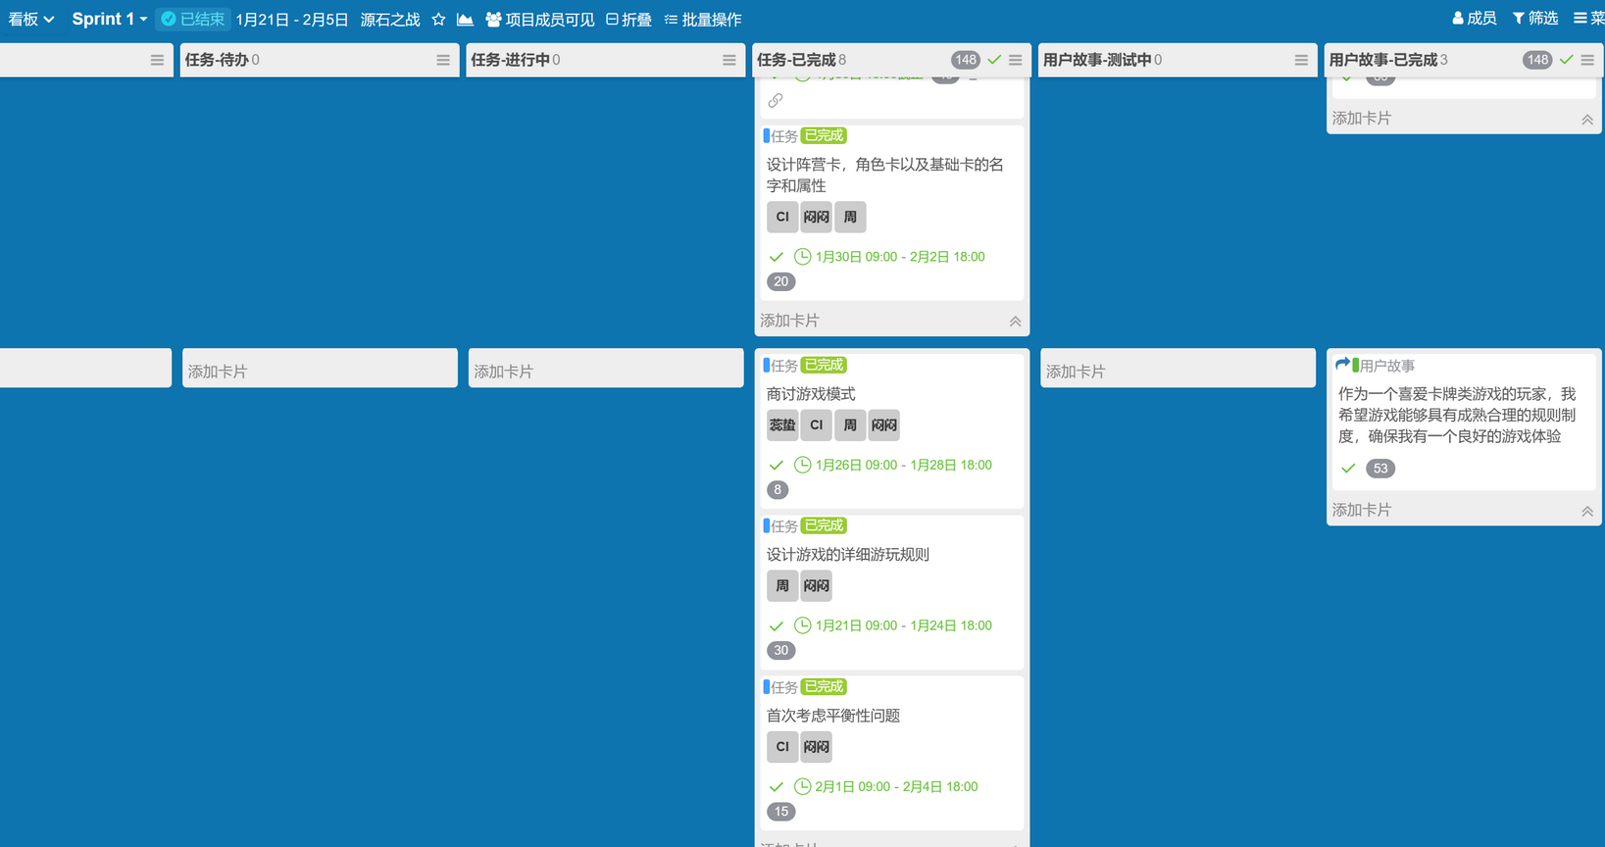
sprint 1 1.21-2.5
Game rule-making
Game balance test

Slide 18
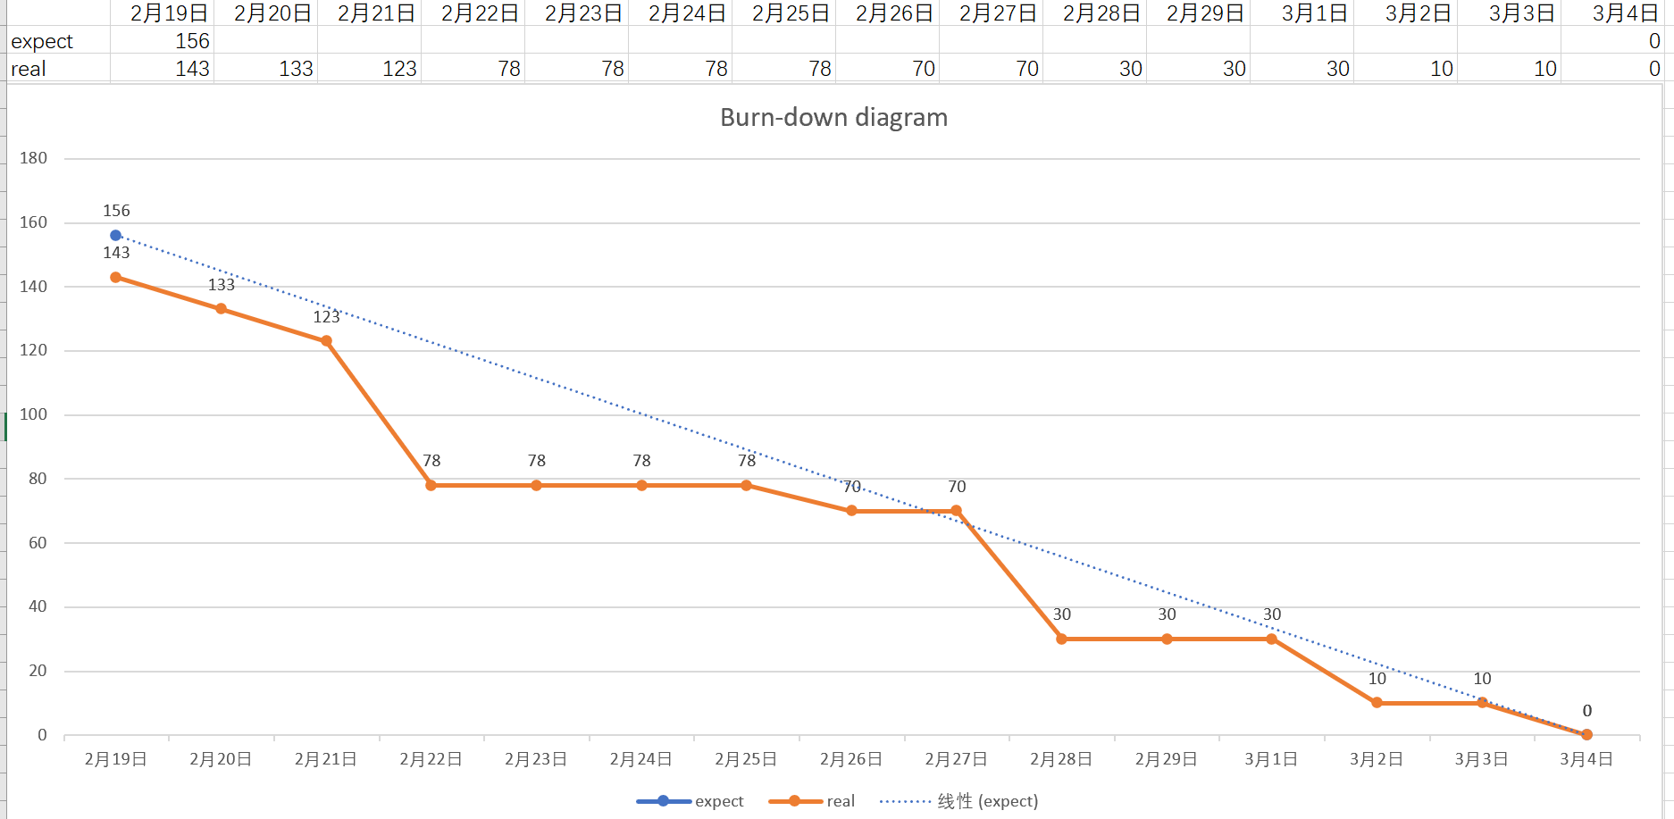

Slide 19
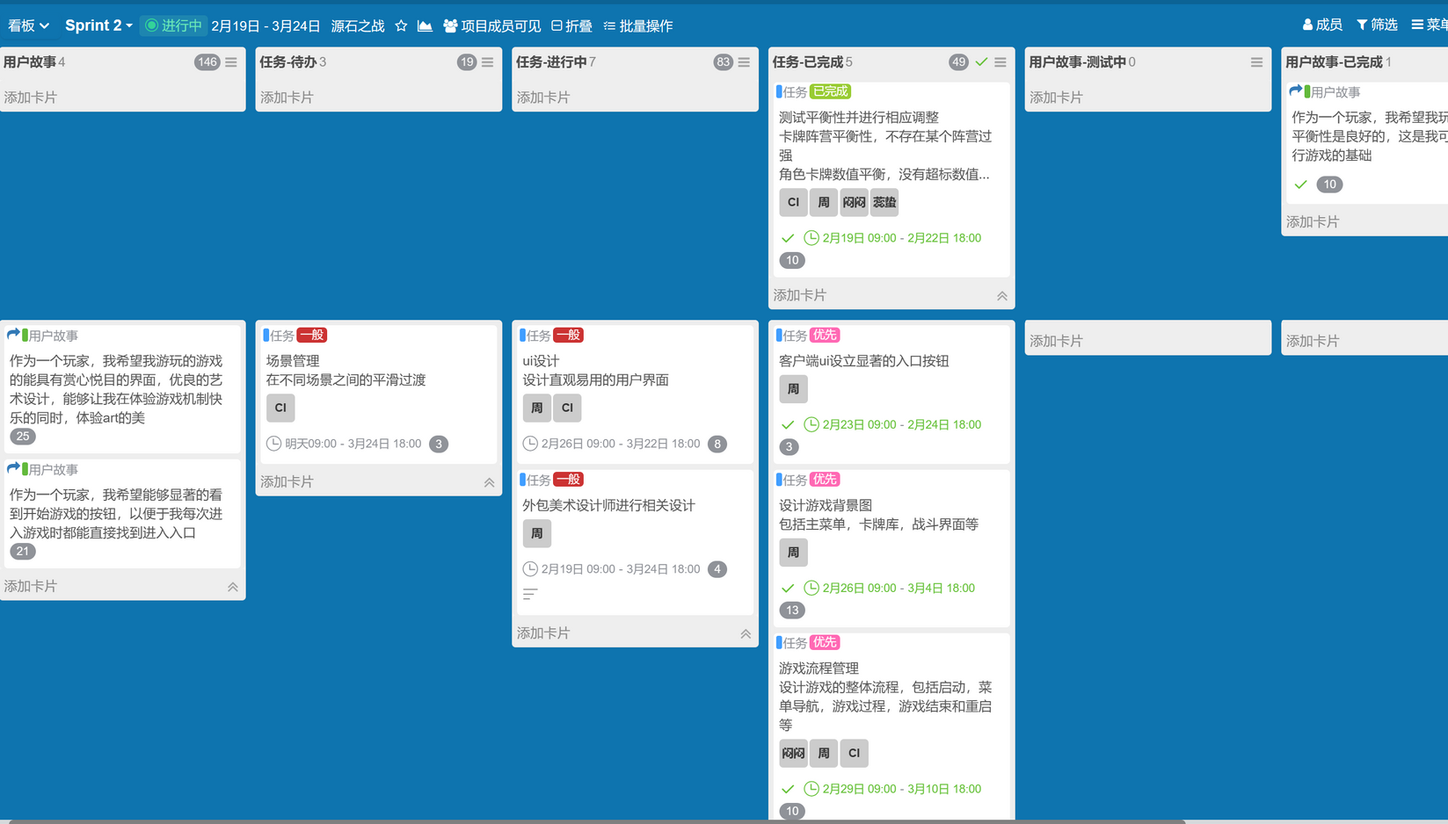
sprint 2 2.19-3.24

Slide 20
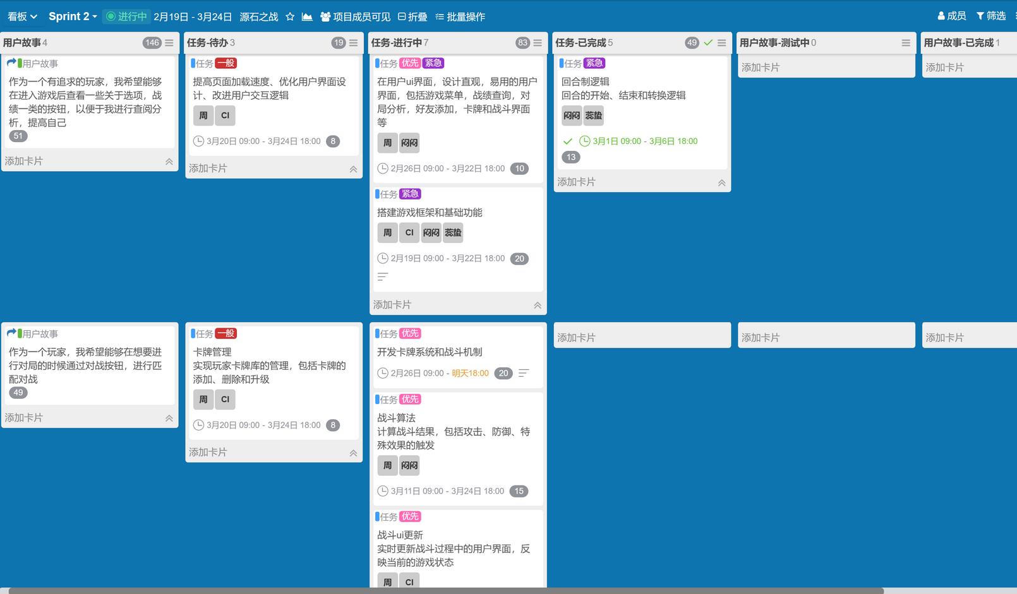
sprint 2 2.19-3.24

Slide 21
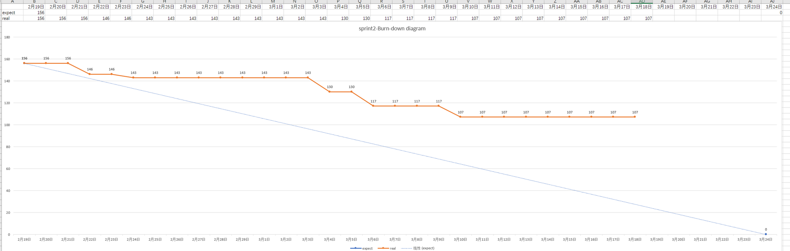

Slide 22
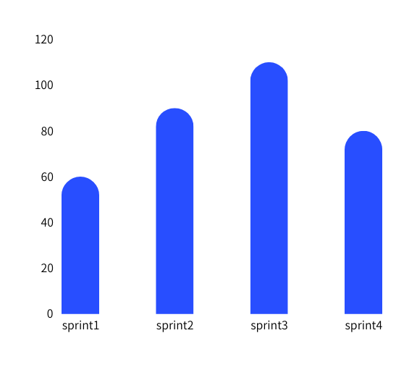
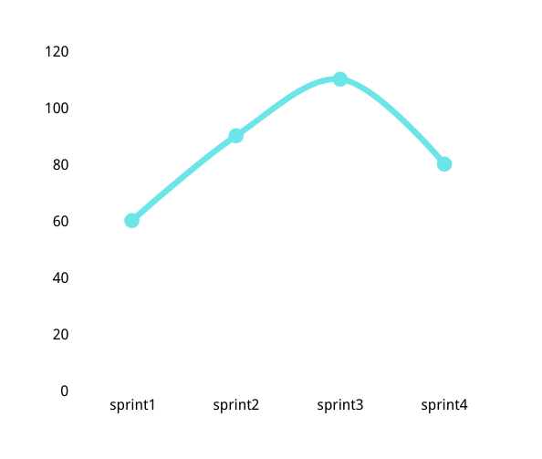
Battle for the Originium
Market research completed
Product analysis background setting
rule making
60%
Completion status
Product design
game framework development
client ui design
art design
bug detection game testing
120%
Follow-up detection
110%
80%

Slide 23
Battle for the Originium
PROJECT EVALUATION
03
Zhou Zitao
Evaluation of software encountered during design testing

Slide 24

Project evaluation
Battle for the Originium
PROJECT METRICS
Line of Code
LOC=2500
Defect Density
Approximately 250 bugs generated
So density = number of bugs to be generated / total lines of code
Task Completion Rate
Total tasks: 24 Completed: 6
Project completion rate = completed/total assignments
Execution Speed
Single play time is about 30min

Slide 25

Process Metrics
Battle for the Originium
Number of bugs before and after release
Average Defect Resoiution Time
Total hours of development
Average Code Review time
Total manpower spent on development

Slide 26


OPPORTUNITY
OPPORTUNITY
Average Code Review time
Battle for the Originium
The total review time for the code was approximately 30h
Approximately 10 code reviews will be conducted.
30h/10times = 3h/times
Review
Average Defect Resolution Time
Total time for all bugs to be solved is about 100h
Number of bugs is about 250
250/100h= 2.5
Resolution

Slide 27

Battle for the Originium
Number of bugs before and after release
Pre-release bugs
Post-release bugs
About 250 bugs
About 50 bugs

Slide 28




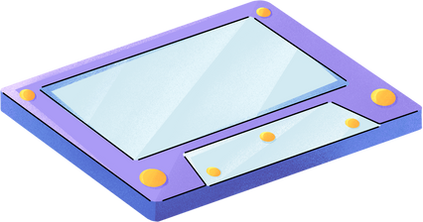
Total time and manpower spent
Battle for the Originium
Total time
manpower spent
four months
four persons

Slide 29
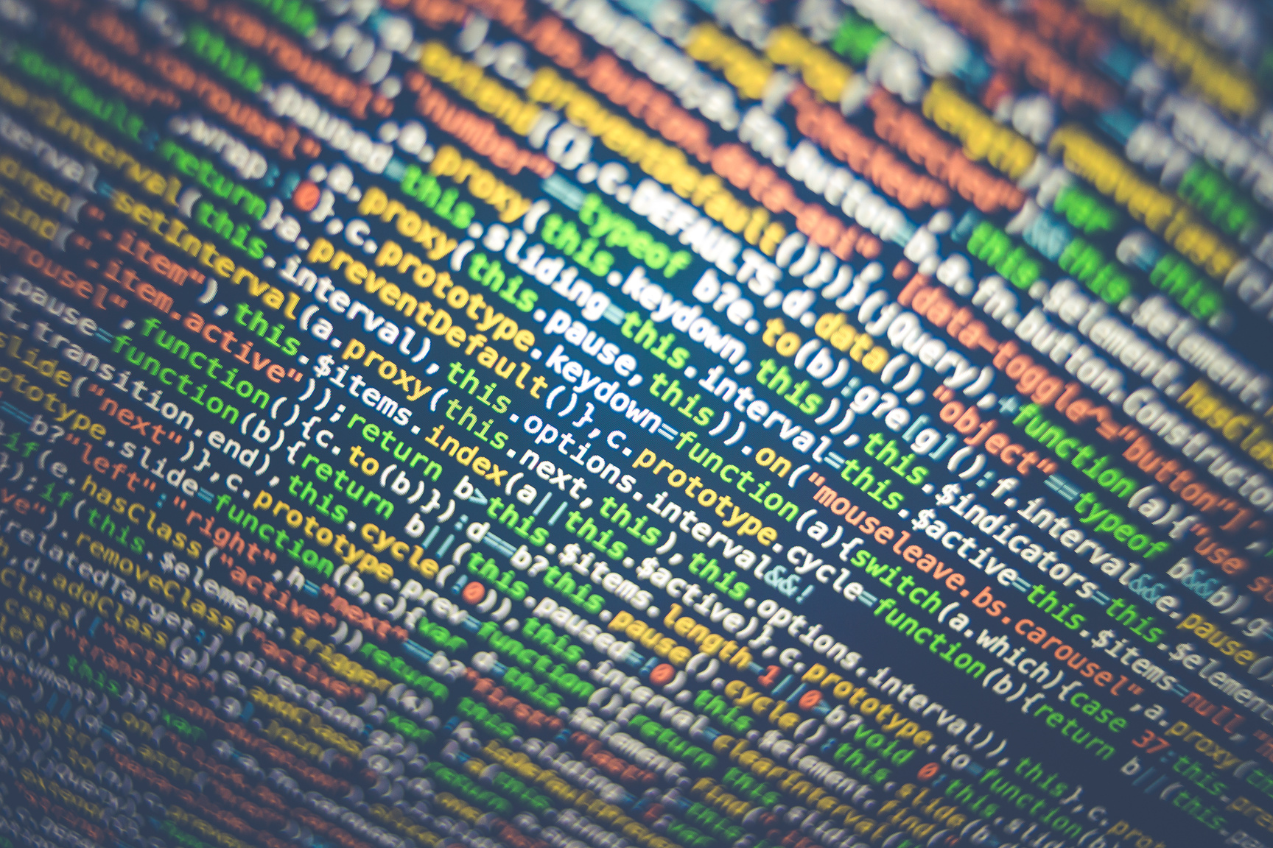
Size-oriented metrics
Battle for the Originium
Per KLOC bug
KLOC = 2.5
ERROR/BUG = 250
Per KLOC bug = 250/2.5 = 100
Money spent per line of code
0
Number of documents per KLOC
Average 50 lines of code one page of documentation
Therefore, the number of document pages per KLOC is
1000/50 = 20 pages

Slide 30
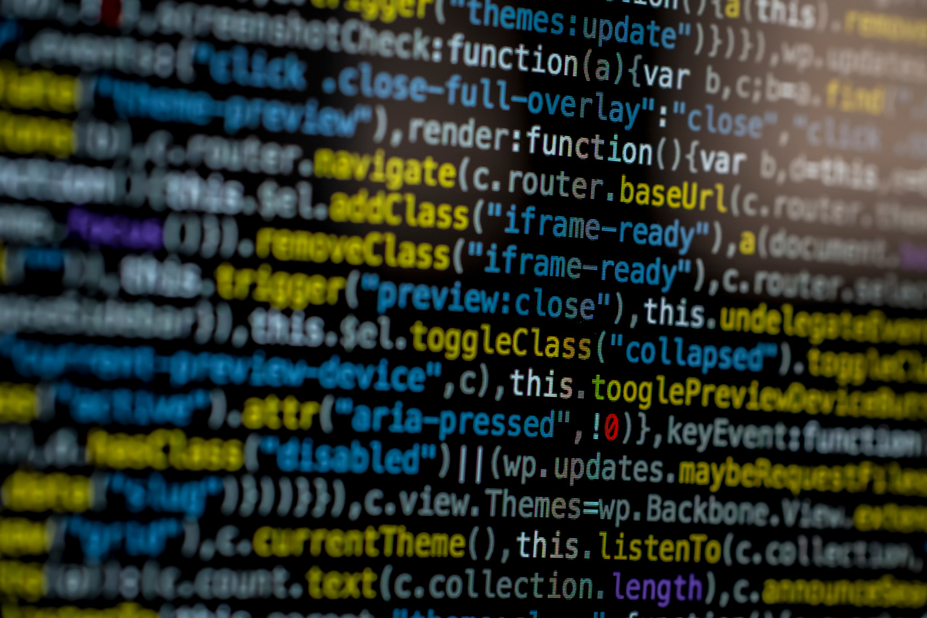
Size-oriented metrics
Battle for the Originium
Code bugs per person per month
Each person generates about 30 errors per month
Lines of code per person per month
Depending on the level of the team, we generate about 300h lines of code per person per month.
Money consumed per page of documentation
0

Slide 31

Battle for the Originium
Function-oriented metrics
Data Function
Trading Functions
ILF
EIF
EI
EQ
EO

Slide 32
Function-oriented metrics
Battle for the Originium
Data Function
Trading Functions
ILF
EI
1.User enters account password (play)
2.User performs action (game content)
3.User query mechanism (enter account password to query)
4.User query card library
1.Player's personal performance information
2.Information on all card libraries
3.Card Interaction Function Library
EQ
1.Demonstrate the effect of the player's operation
2.Showing the results after querying
3.Showing details of the cards in the deck
EIF
1.Converting User Actions to Functional Expressions
2.Establishing client-side calls to card libraries
3.Creating queries for user data
4.Cross-client communication of actions
EO
1.Player Performance Cloud Delivery
2.Layer Action Execution Sending

Slide 33
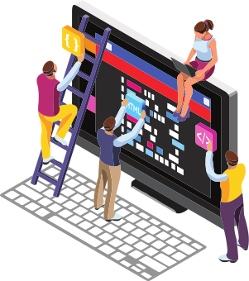

Function Point Calculation
Battle for the Originium
FP=10ILF+7EIF+4EI+5EO+4EQ
10*3+7*4+4*4+2*5+4*3
=96
AFP
Early stage: FP*1.5 = 144
Middle stage: FP*1.26 = 120.96
End: FP*1.0 = 96

Slide 34
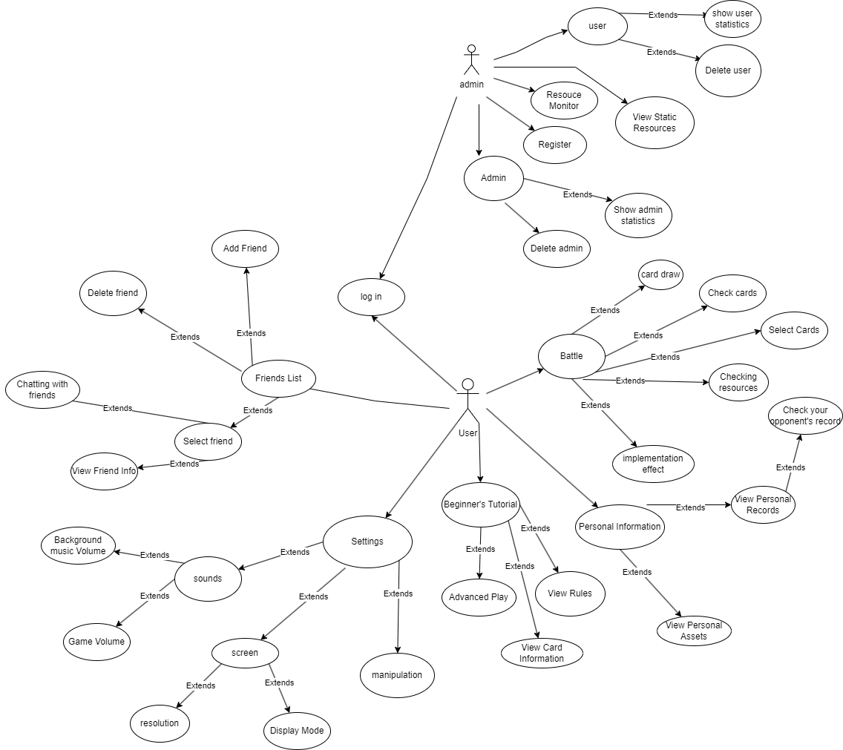
Battle for the Originium
Use-case oriented metrics
Average use case size
There are 38 scenes in total
A total of 26 use cases exist
Average use case size = 38/26 = 19/13
Average use case delay
Completion time is approximately 120 days
Average of 4.85 days per case
Delay of 2 days per case
Average use case delay = 2*26/26 = 2days

Slide 35
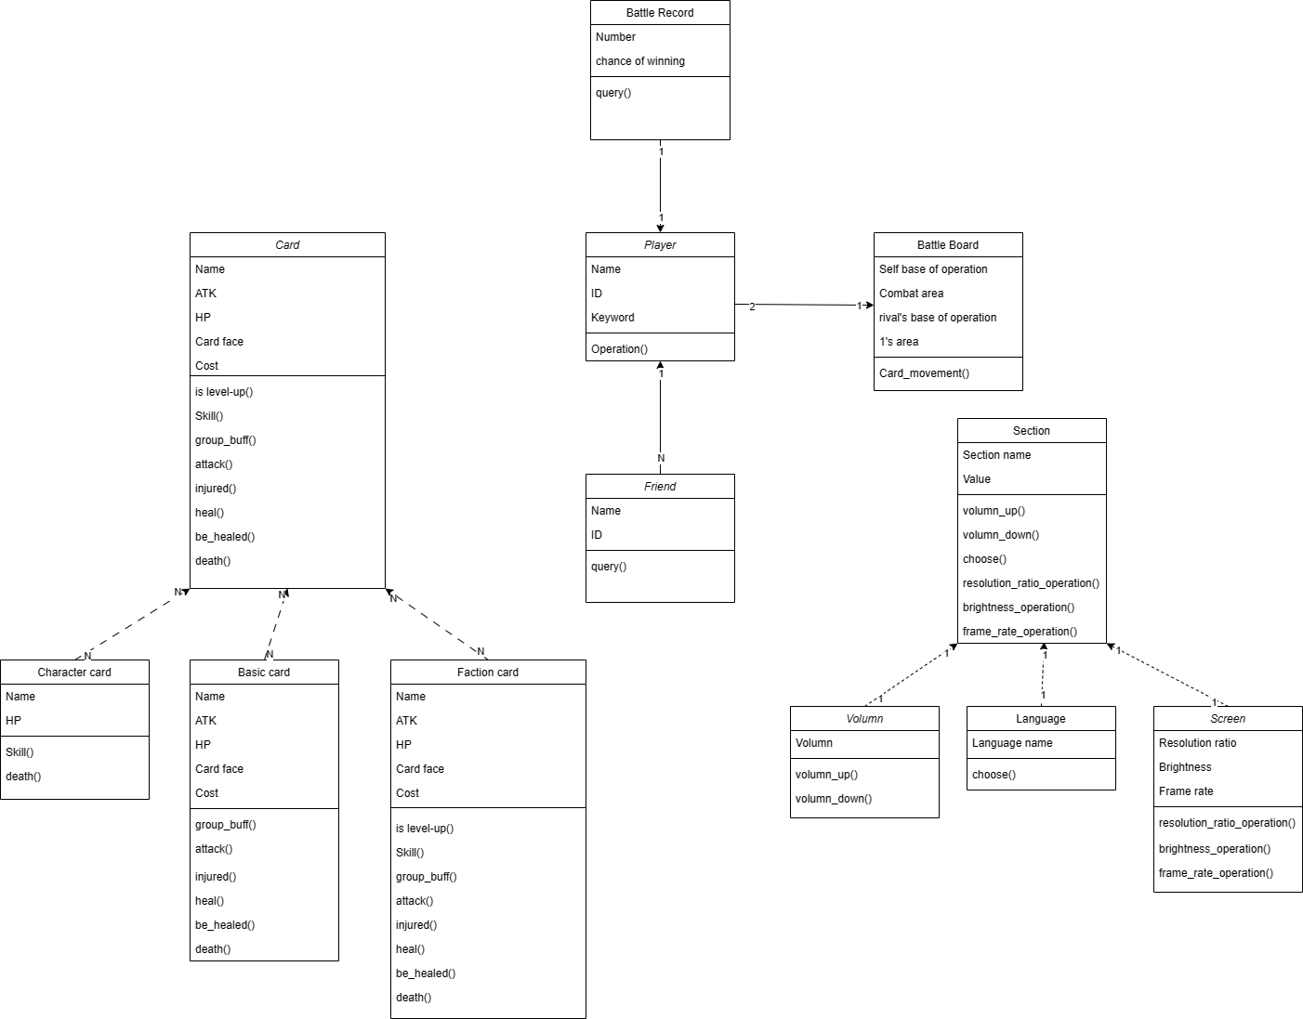
Battle for the Originium
Object-oriented metrics
Class Complexity
WMC:
Card=19, Character card=6, Basic card=14, Faction card=19, Battle record=2.Player=3, Friend=2, Battle Board=2, Section=6, Volumn=2, Language=1, Screen=3
Depth of Inheritance Tree
DIT:
Card=1,character card,basic card, faction card=2,Section=1,volumn,language,screen=2
All other values are 1

Slide 36

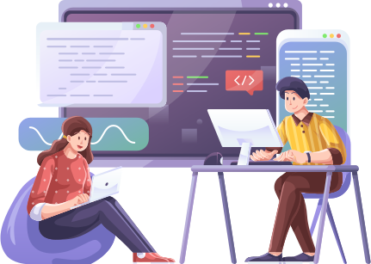
Battle for the Originium
Software Quality metrics
Error per KLOC
MTTC
Integrity
Usability
MTTC = Σ（Time of change）/Number of changes
50h/10 = 5
threat = 40%
security = 70%
so
integrity = 1-(0.4*(1-0.7)) = 0.88
A questionnaire was taken to determine the complexity of the game's rules and thus the ease of use.
250/2.5 = 100

Slide 37
Battle for the Originium
Defect Removal Effcience
E
D
DRE
Pre-release bug
250
Bugs after release
50
D/(D+E)=1/6
DRE can also be applied to errors in activity i
DRE = ei/(ei+ei+1)

Slide 38
Software feasibility
Battle for the Originium
technology
Technically feasible, sufficiently advanced
finance
time
Low financial cost
The game is interesting and the market is broad
unmarketable

Slide 39
Battle for the Originium
size of software
2500 loc
the size is about 100mb-300mb
50+ PNG
5 songs

Slide 40
Battle for the Originium
Estimation model
walston - Felix model
Bailey - basili model
Boehm simple model
E= 5.2*(2.5)^0.9
=11.86
E=5.5 +0.73*2.5^1.16
=7.61
E = 3.2*(2.5)^1.05
=8.38
Doty model
kloc<9

Slide 41
OPPORTUNITY
OPPORTUNITY
Estimation model for FP
Battle for the Originium
Kemerer model
E = -37 + 0.96FP=55.16
Small project regression model
E = -12.88+0.405FP=26

Slide 42


Battle for the Originium
cocomo model
E=
[LOC*B^0.333/
P]^3*(1/T^4)
PROD=7
NOP➗
Person/month
t=6b=0.16 p=7 E= 5534.97

Slide 43
Battle for the Originium
FINAL REPORT
04
Lei Nuozhen
Summary of reports on current software development progress

Slide 44
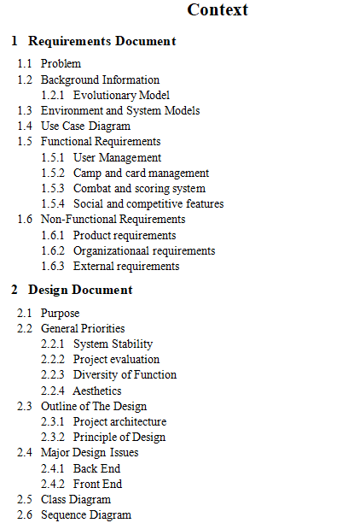


Battle for the Originium
Context

Slide 45
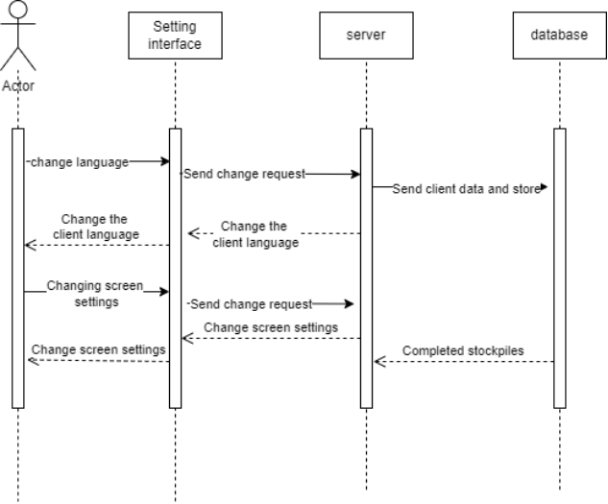
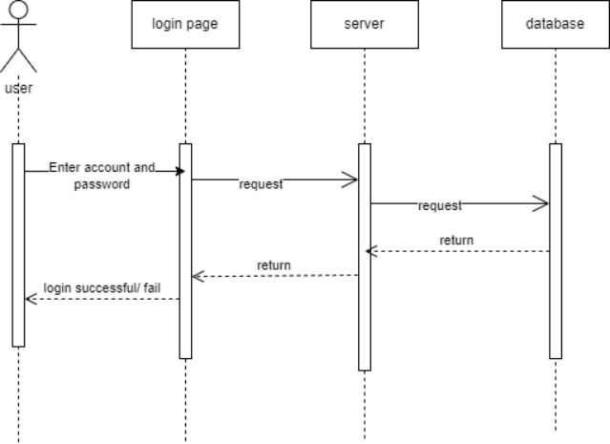
Sequence diagram
Battle for the Originium

Slide 46
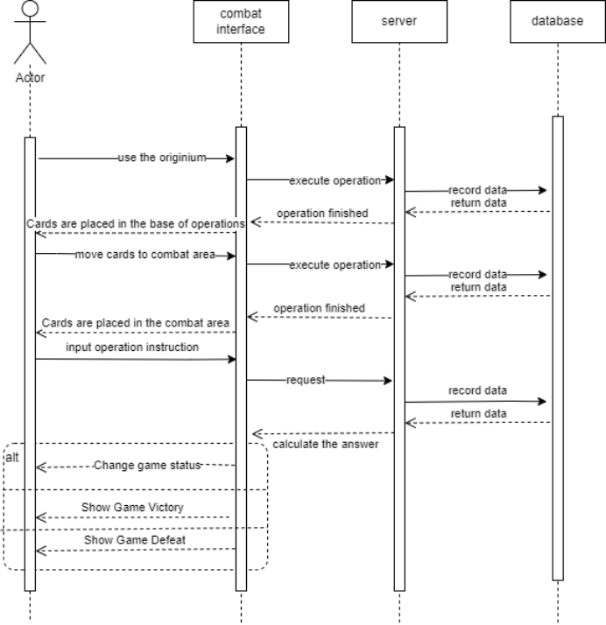
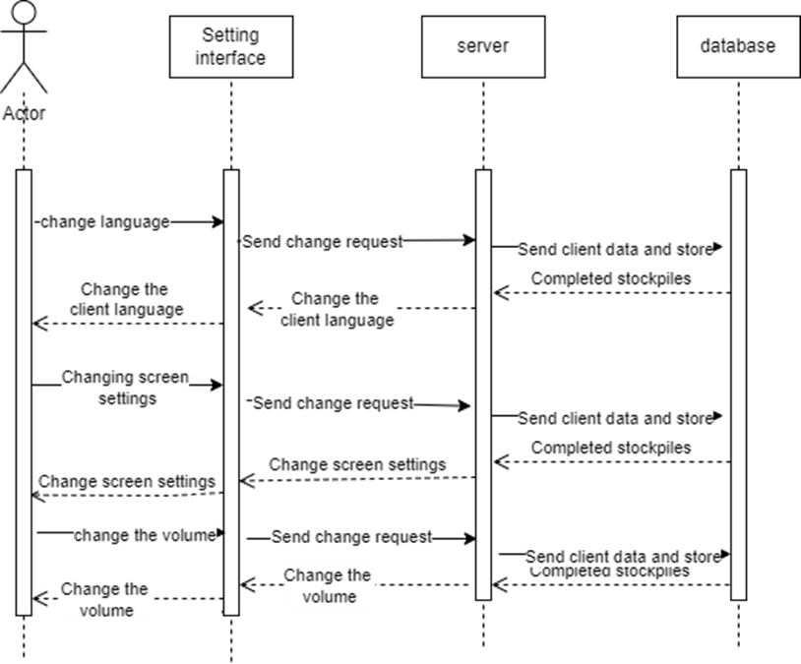
Sequence diagram
Battle for the Originium

Slide 47
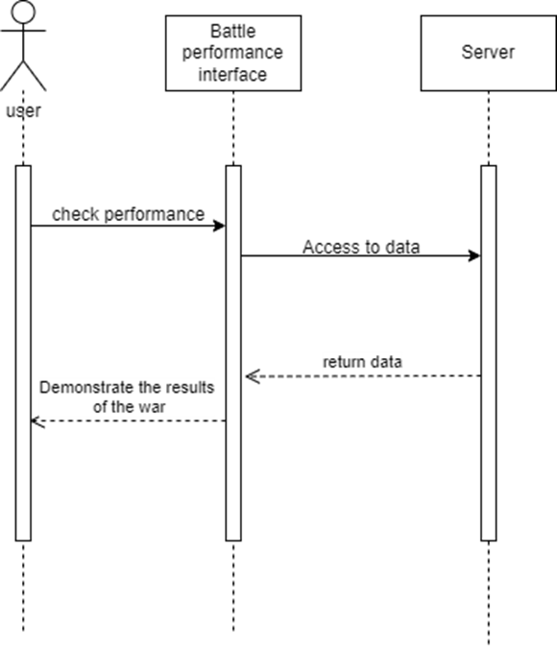
Sequence diagram
Battle for the Originium

Slide 48
Battle for the Originium
2024
THANK YOU
Name:Leinuozhen
Zhouzitao
Zhongruizhe
Wanglin
Date:2024/3/19

